Slide 1

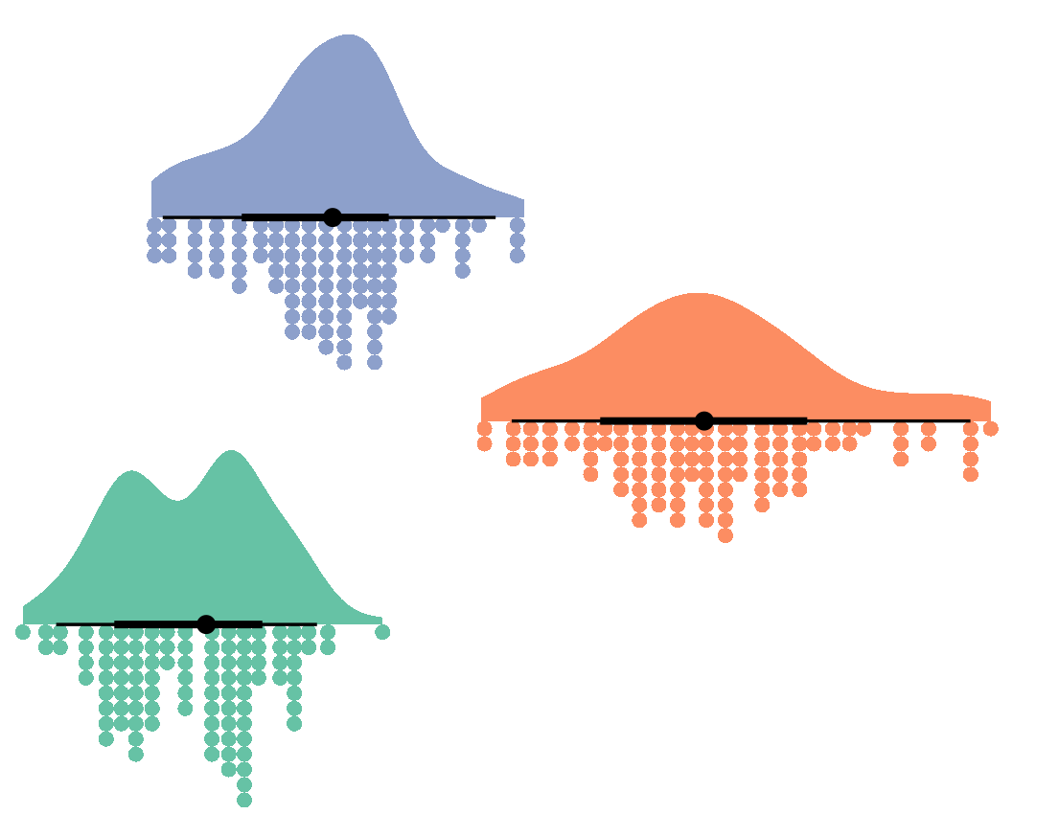


Welcome to
Visualisation
Joseph M Barnby
07/02/2024
Postgraduate Lectures
Twitter: JoeBarnby

Slide 2
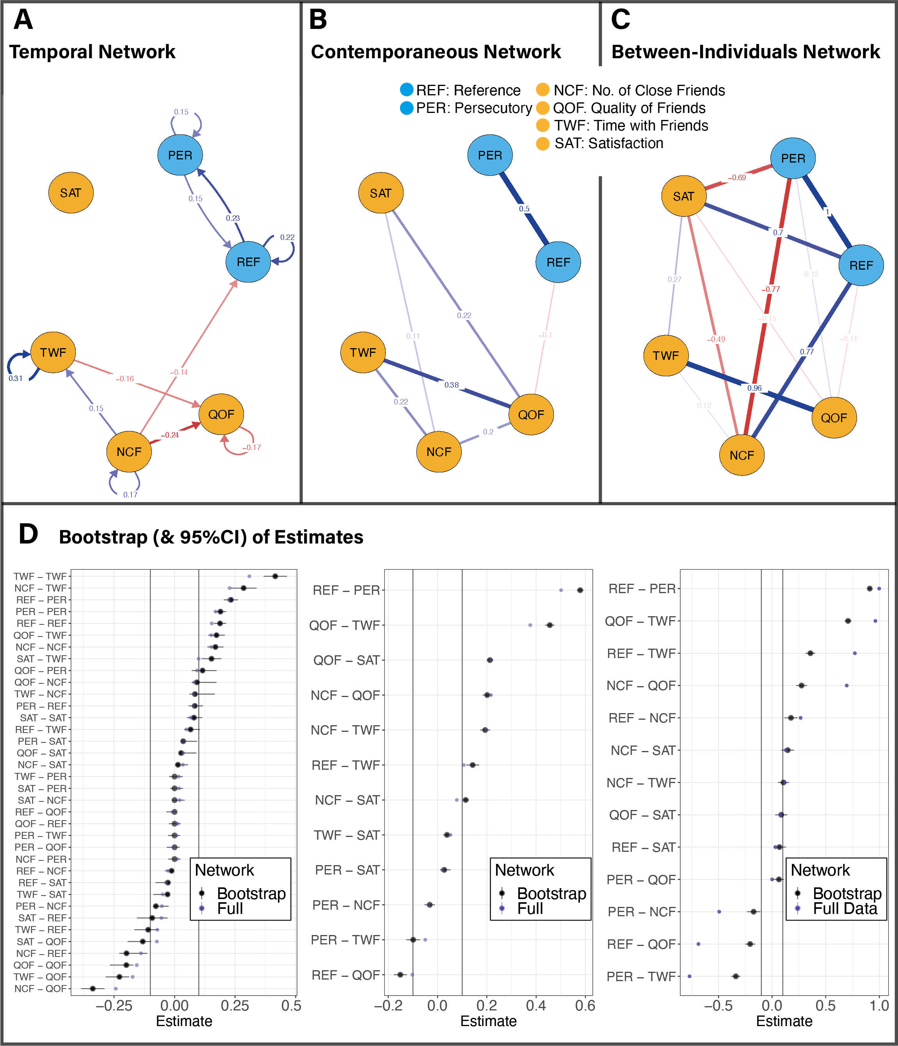
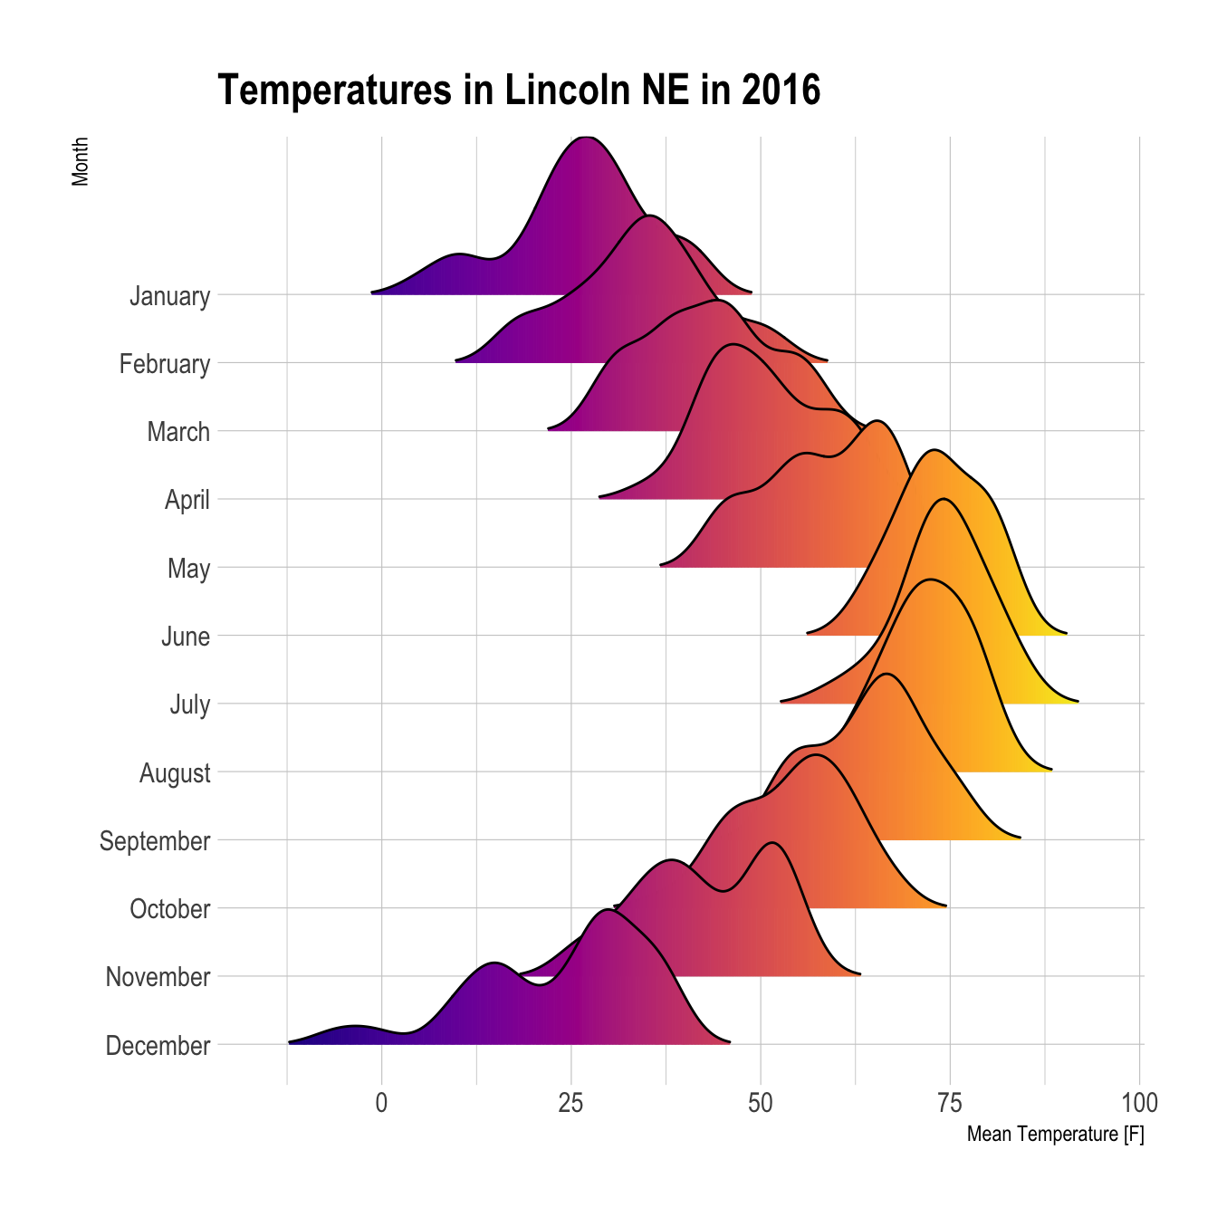


The three lectures
Getting things going (term 1)
Cleaning your data (session 2)
Making beautiful plots and figures (today)

Slide 3

Our data….

Slide 4

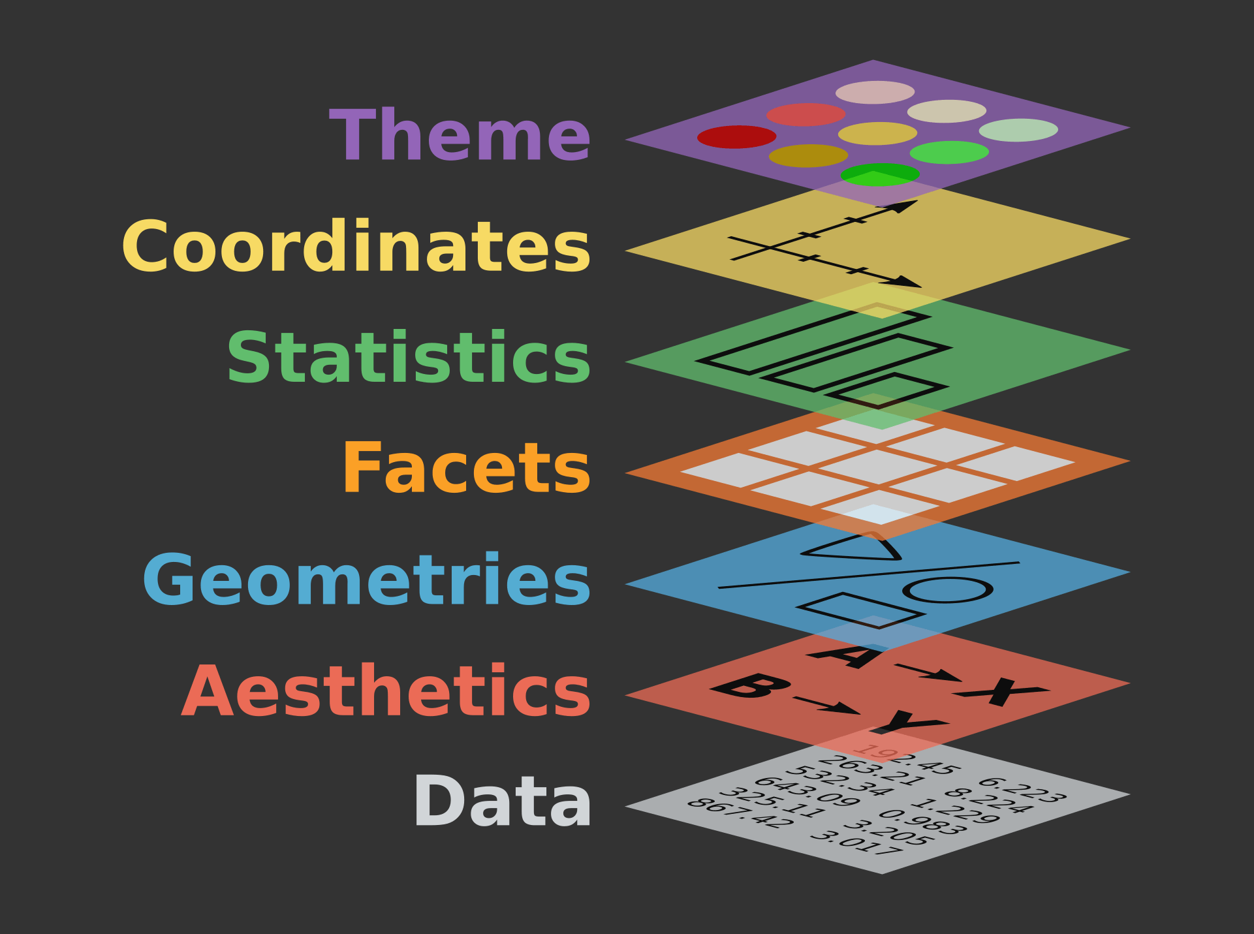
The Grammar of Graphics

Slide 5
The Grammar of Graphics

Slide 6
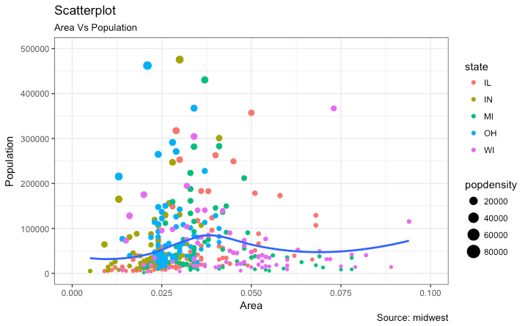
The Grammar of Graphics

Slide 7
Building our plot
https://github.com/josephmbarnby/BeginR/blob/master/RHULScript/Intro_to_dataviz.R

Slide 8
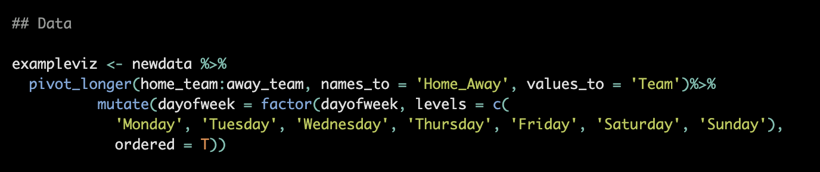
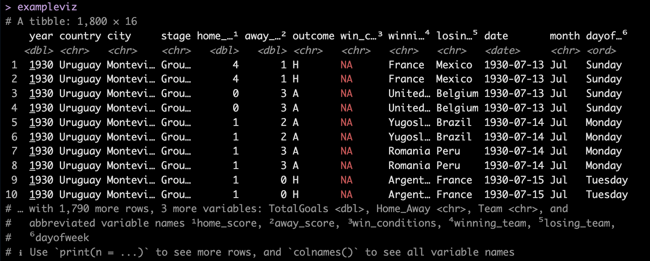
Building our plot

Slide 9
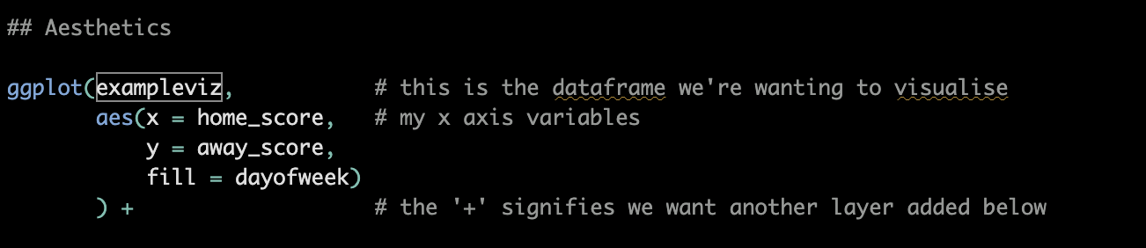
Building our plot

Slide 10
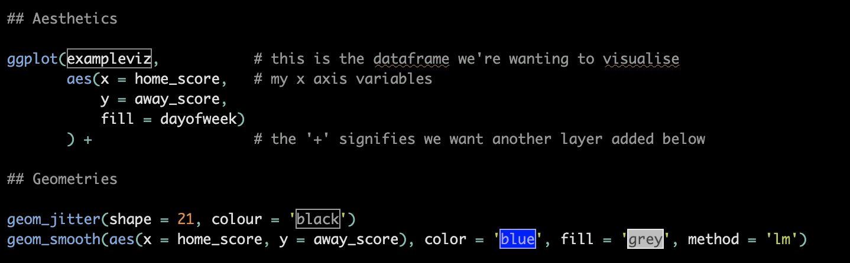
Building our plot

Slide 11
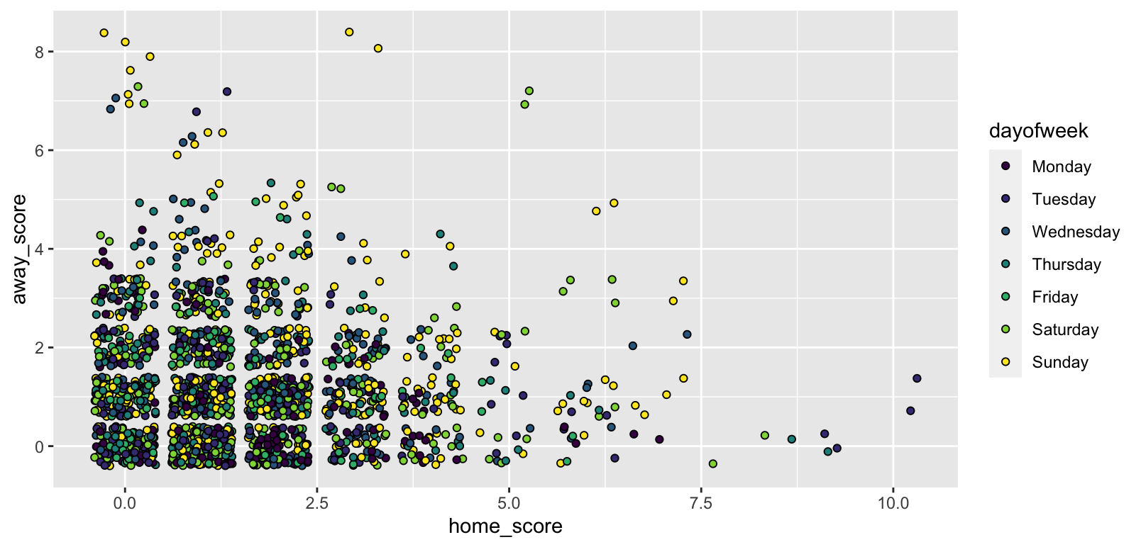
Building our plot

Slide 12
Building our plot

Slide 13
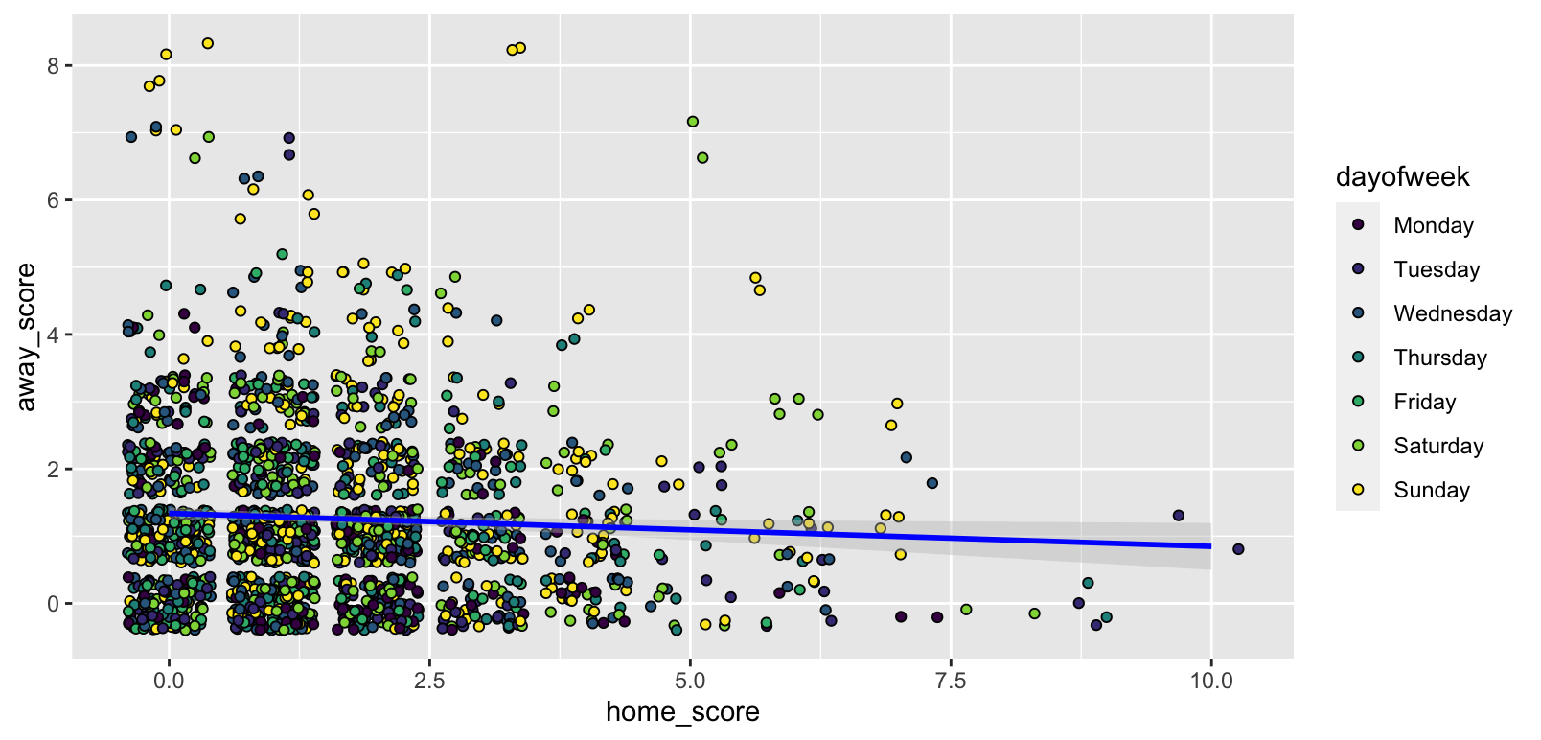
Building our plot

Slide 14
Building our plot

Slide 15
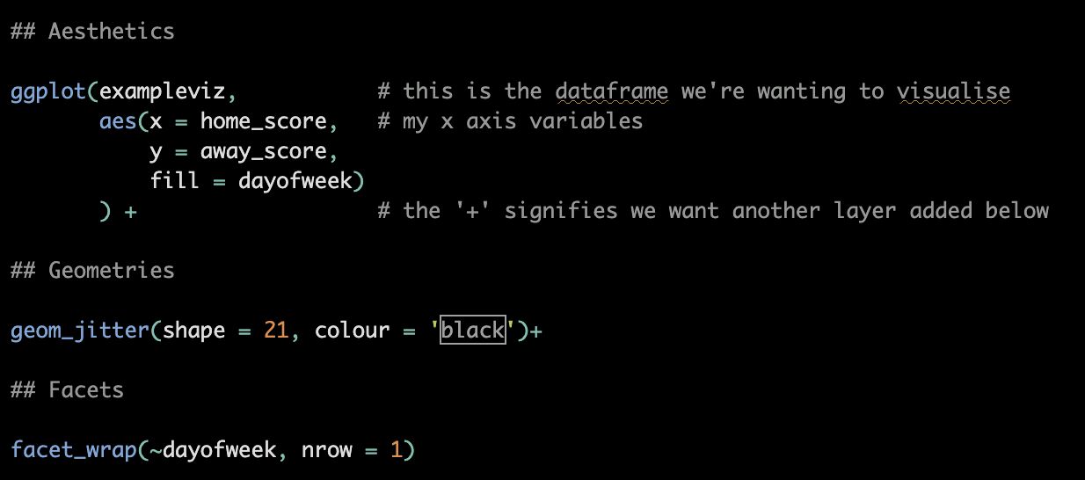
Building our plot

Slide 16
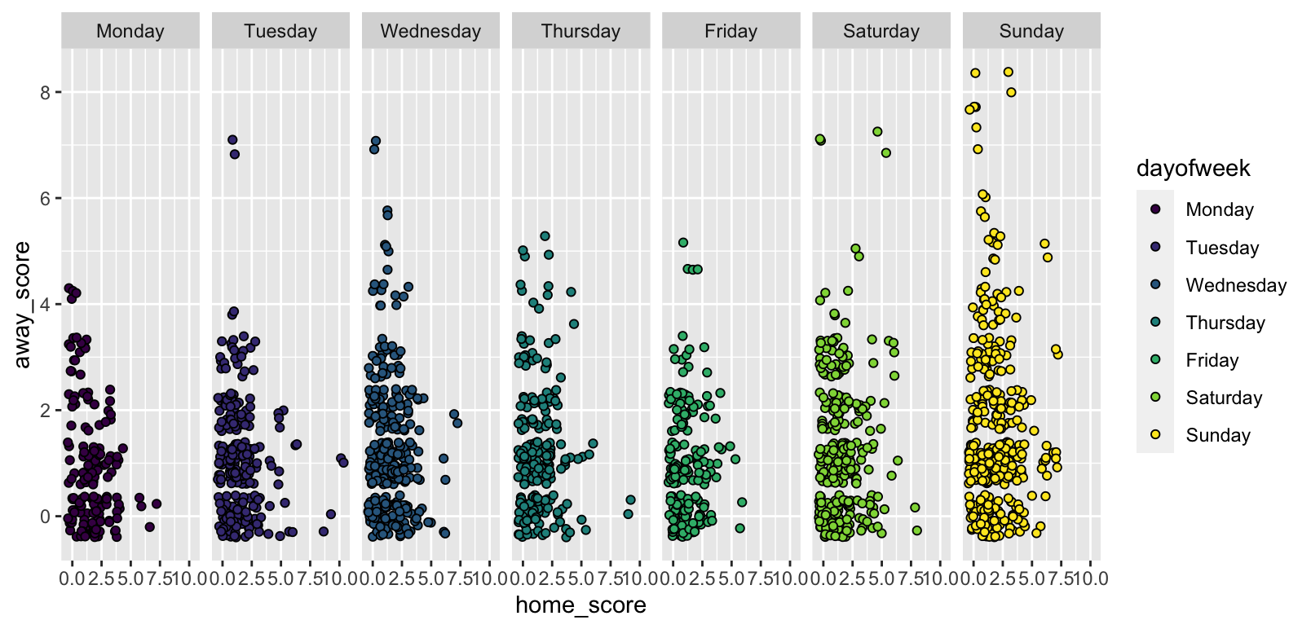
Building our plot

Slide 17
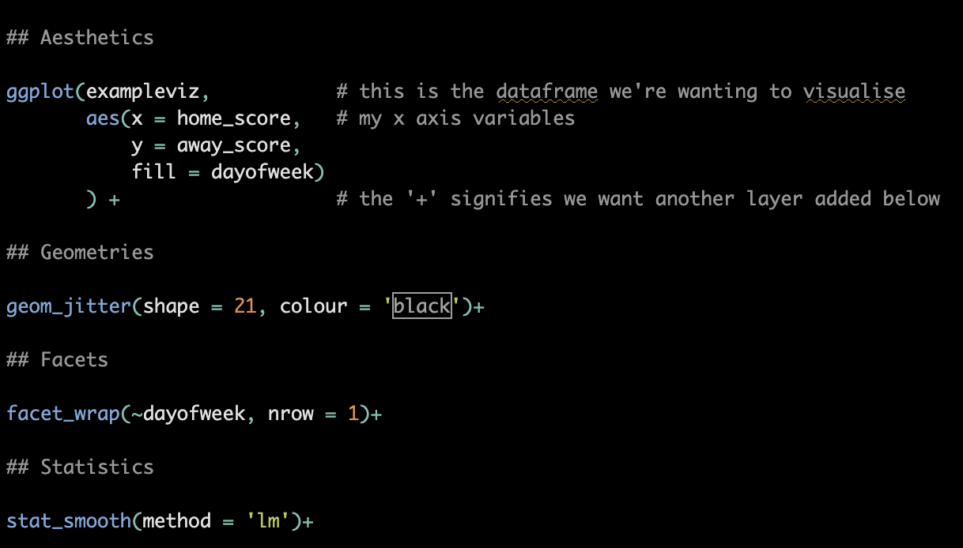
Building our plot

Slide 18
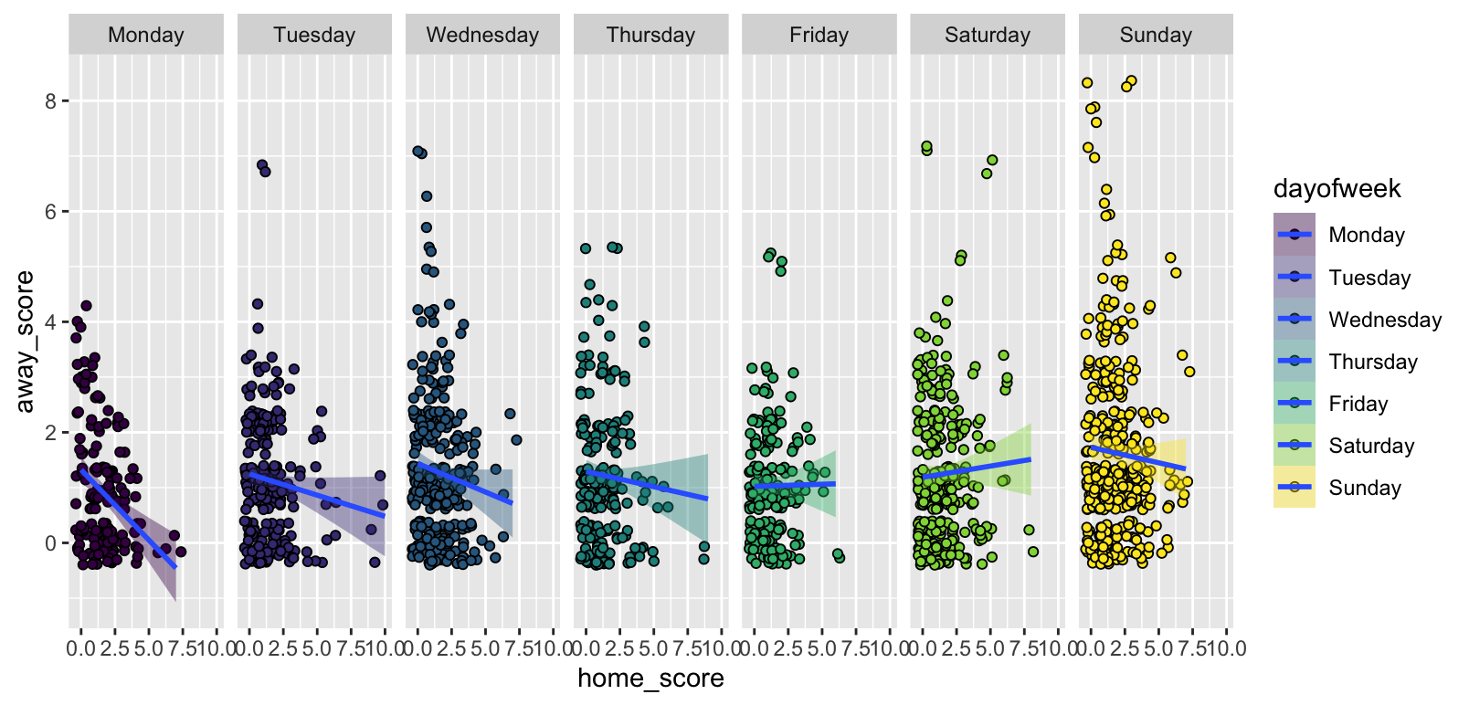
Building our plot

Slide 19
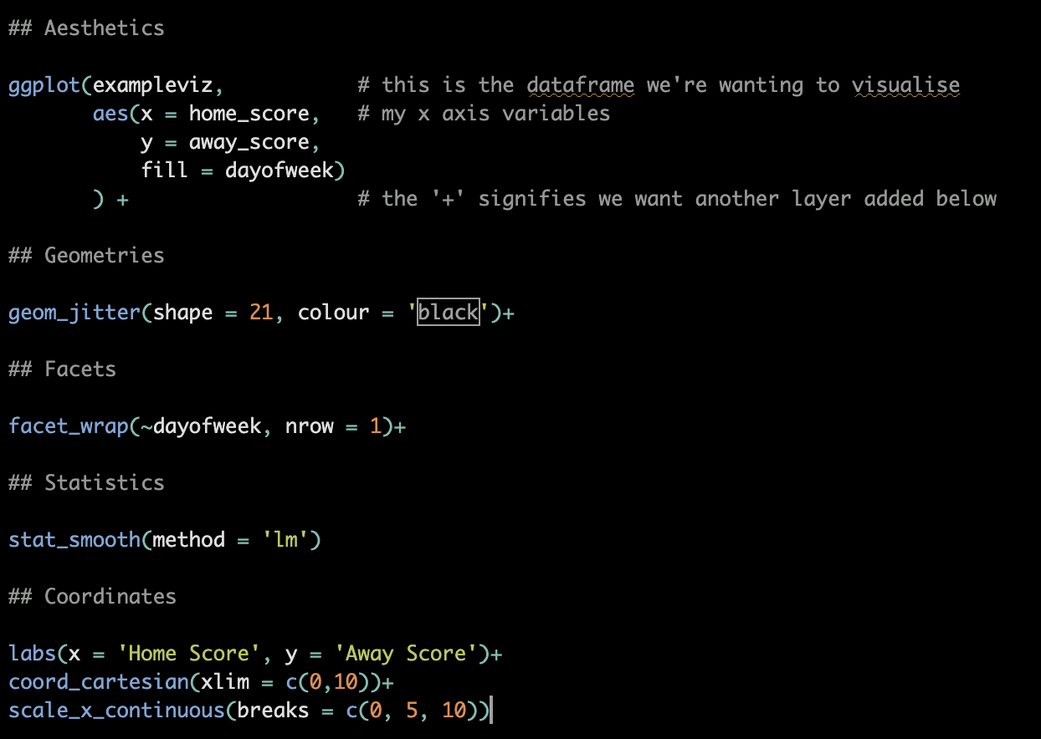
Building our plot

Slide 20
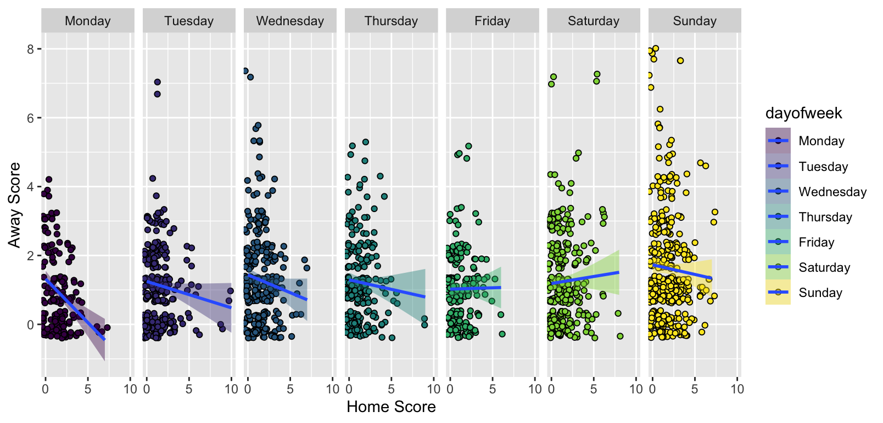
Building our plot

Slide 21
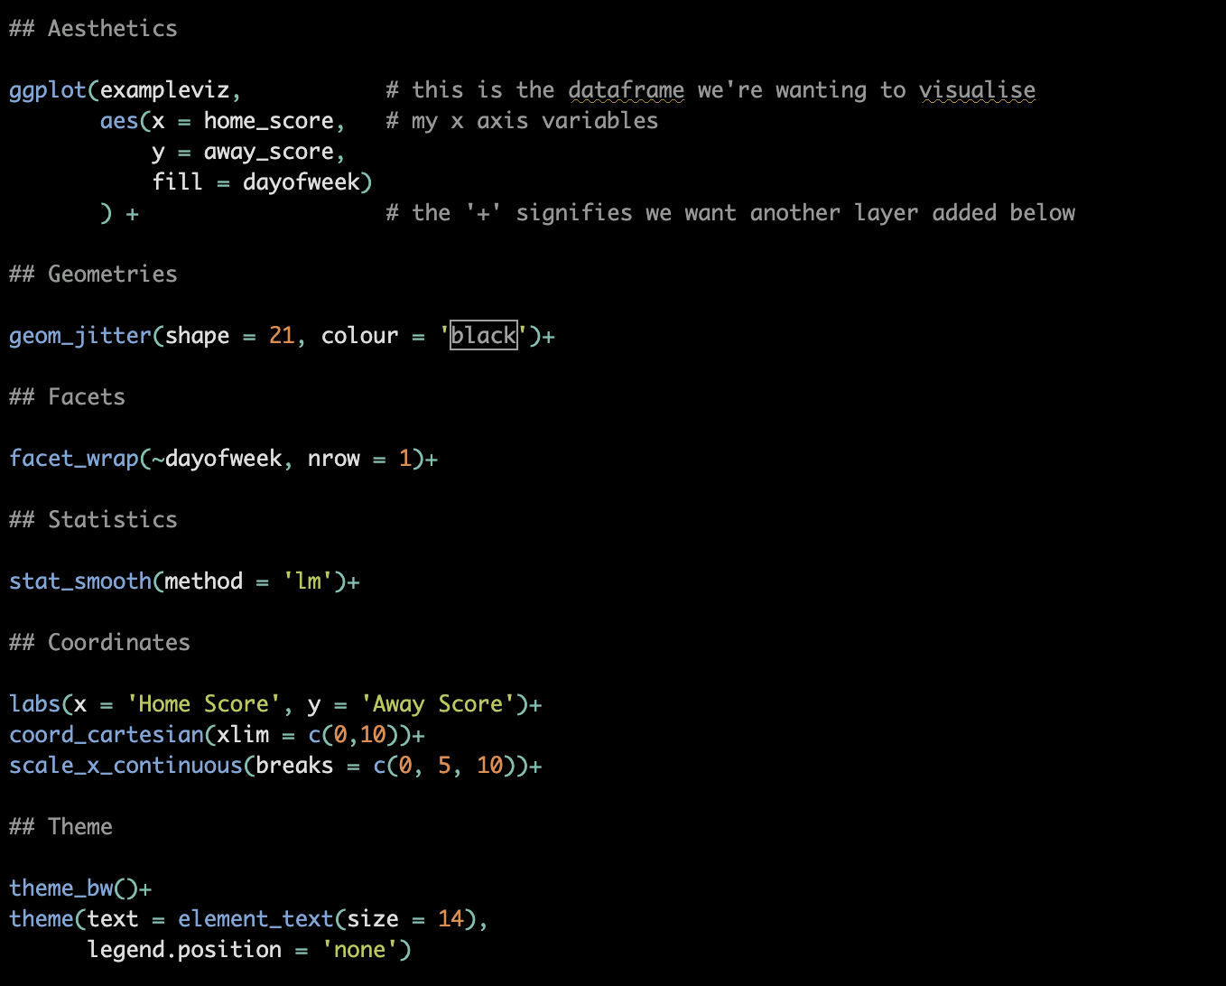
Building our plot

Slide 22
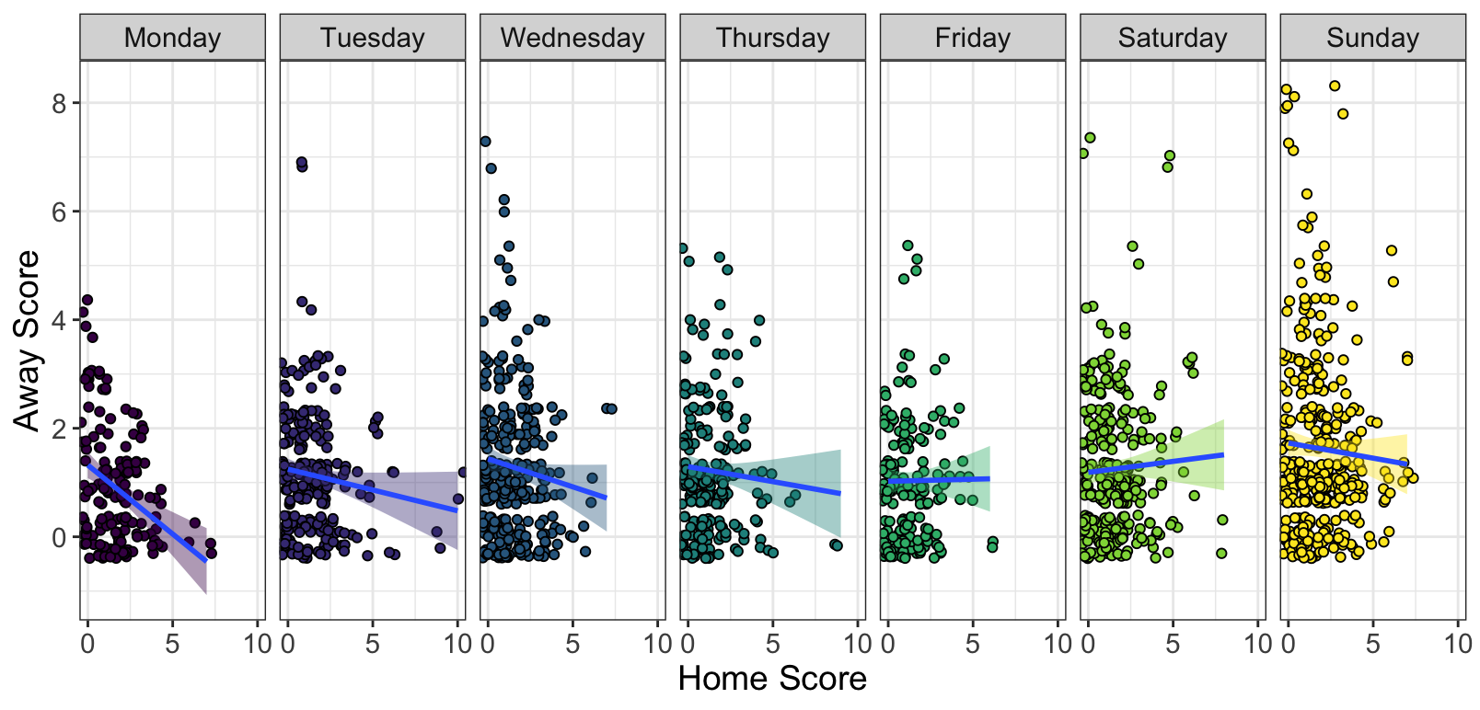
Building our plot

Slide 23

Building our plot

Slide 24
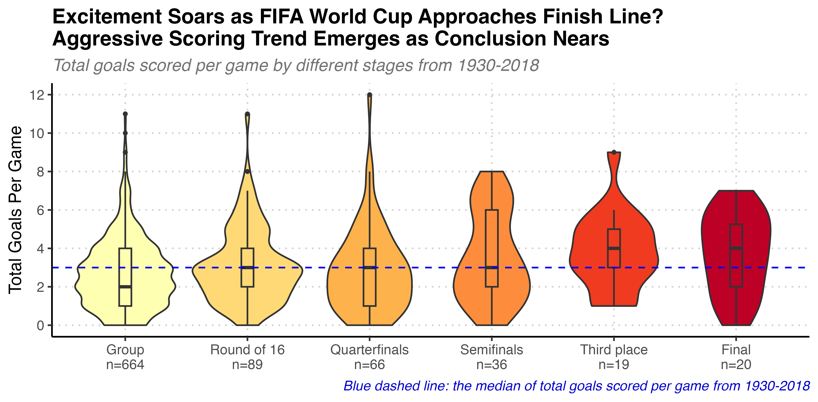
Cheng-Yu Hsieh

Slide 25
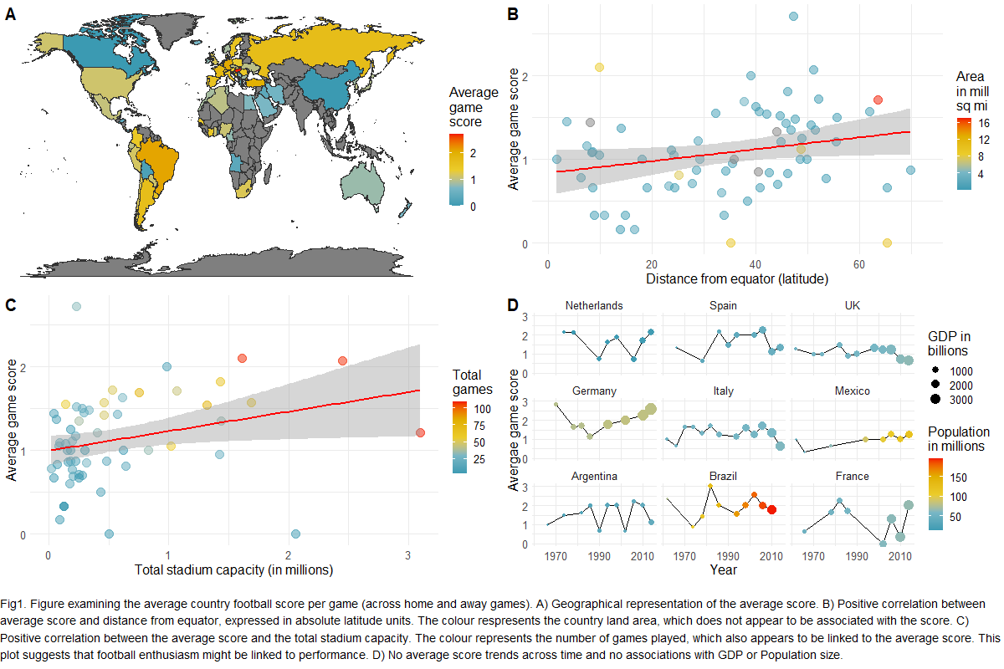
Desi Arabadzhiyska

Slide 26
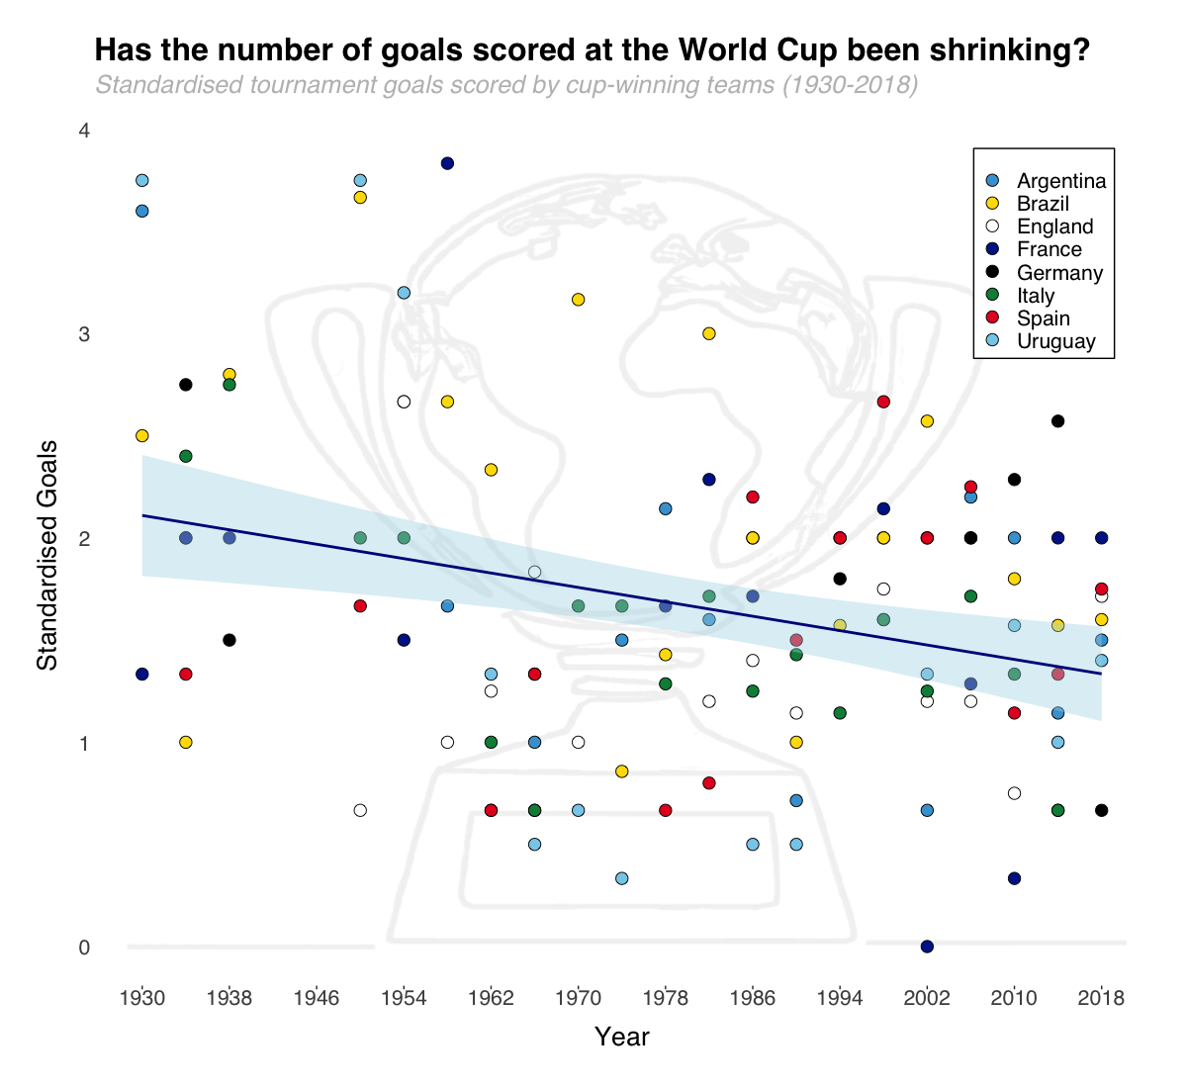
Ryan Jefferies

Slide 27
The Grammar of Graphics
Your turn!
https://github.com/josephmbarnby/BeginR/blob/master/RHULScript/Intro_to_dataviz.R

Slide 28
Data Visualisation Competition
Data has to be the World Cup data from TidyTuesday
Can be anyone who would like to participant (not just workshop attendees)
Two weeks. It closes on the 21st of Feb at Midday.
There will be three tiers:
Up to PhD (£50 Amazon Voucher)
Postdoc
Staff
All winners and runners up will be featured on a blog post with their code available for anyone to replicate it.
We will be judging on three criteria:
Clean code
Aesthetics
Data clarity

